Slide 1
TO STUDY BREWSTER’S LAW USING LASER LIGHT
AIM
To determine the of Brewster’s angle for glass using a polarized light source.
APPARATUS USED
Laser, Polarizer, Glass plate, Plate holder, Rotational mount, Detector, Current output unit.

Slide 2
THEORY & FORMULA USED
When light travels from one media to another having different refractive indices, some of the light is reflected back from the surface of the denser medium. This reflected ray’s intensity changes with change in the angle of incidence at the interface of two media. At one specific angle of incidence of light only perpendicular vibrations of electric field vectors are reflected whereas parallel vibrations are blocked. The angle of incidence for which reflected ray is polarized is called the Polarization angle (θ_{P}) or Brewster's angle.
Brewster’s angle for a given medium is
Where µ is refractive index of the medium and θ_{p} Polarization angle.

Slide 3
PROCEDURE
Open the given link in a window
http://lo-au.vlabs.ac.in/laser-optics/Brewsters_Angle_Determination/experiment.html
2. Select the medium (air), material (Crown Glass) and click the switch ON light.
3. Rotate the glass plate at an interval of 5 degree, note down the rotation angle (θ) and corresponding current value (I) .
Plot a graph of reflected power (current I) vs angle θ.
From the graph find Brewster’s angle as well as refractive index of the material.

Slide 4
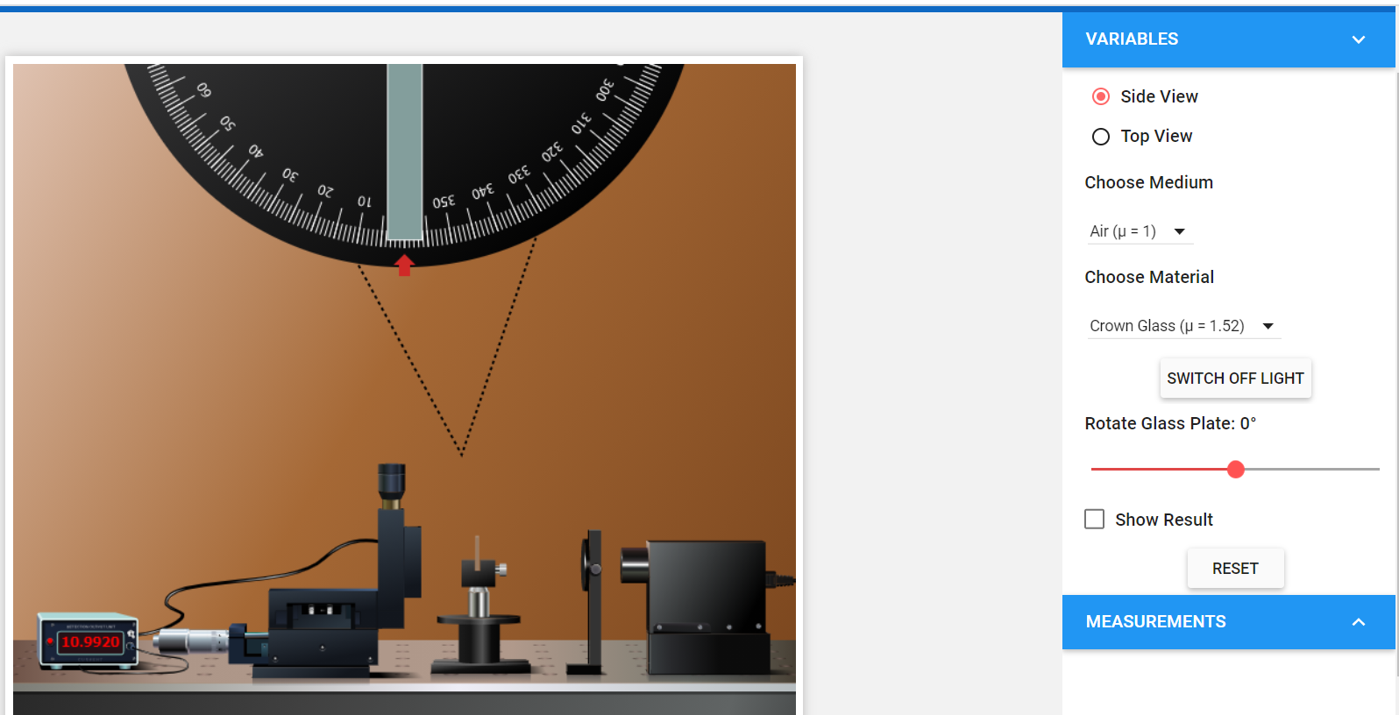
BREWSTER’S LAW SETUP (VIRTUAL)
Link : http://lo-au.vlabs.ac.in/laser-optics/Brewsters_Angle_Determination/experiment.html
Select
Select

Slide 5
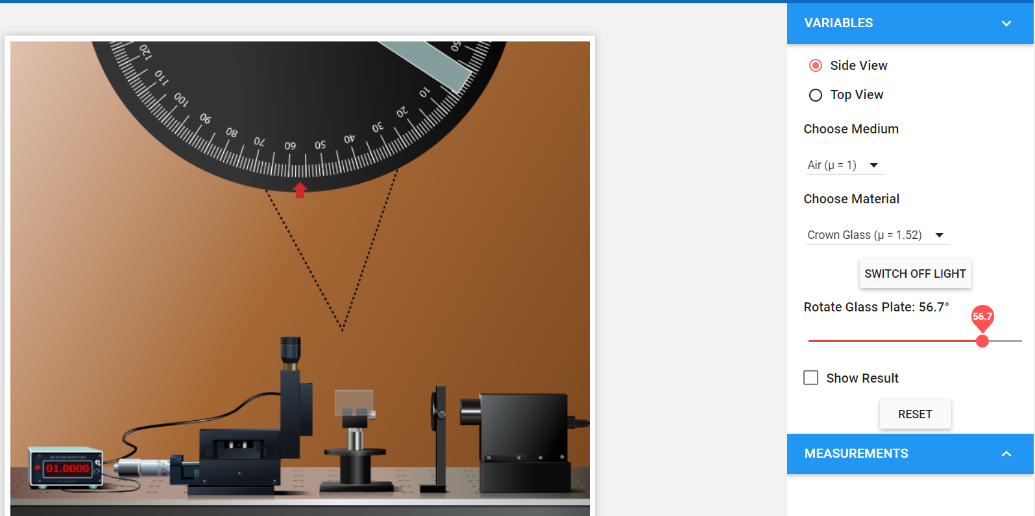
BREWSTER’S LAW SETUP (VIRTUAL)
Rotate the angle, till current value becomes minimum
Current becomes minimum

Slide 6
BREWSTER’S LAW VERIFICATION
Theoretical Calculation
OBSERVATION TABLE
Rotation Angle θ (in degree)
Current (I)
RESULT
Plot a graph of reflected power (current I) vs angle θ.
Brewster’s angle for the material is ……………
The refractive index of material of glass is …………

Slide 7
TO STUDY MALUS’ LAW USING LASER LIGHT
AIM
To determine the relationship between the intensity of the transmitted light through analyzer and the angle between the axes of polarizer and analyzer.
APPARATUS USED
Laser, Polarizer, Analyzer, Photo Detector, Detector output measuring unit, optical bench.

Slide 8
THEORY & FORMULA USED
When light falls on a polarizer, the transmitted light gets polarized. The polarized light falling on another Polaroid, called analyzer, transmits light depending on the orientation of its axis with the polarizer. The intensity of light transmitted through the analyzer is given by Malus’ law. This law describes how the intensity of light transmitted by the analyzer varies with the angle that its plane of transmission makes with that of the polarizer. The law can be mathematically written as:
I_{t}= I_{o} Cos² θ
where I_{t} is the intensity of the light transmitted through the analyzer; and I_{o} is the intensity of the incident plane polarized light.
Polarizer Analyzer Detector
To Meter
Laser
I_{o}
I_{t}= I_{o} Cos² θ

Slide 9
PROCEDURE
Open the given link in a window
http://lo-au.vlabs.ac.in/laser-optics/Malus_law/experiment.html
2. Click on the Power ON knob.
3. Rotate the Polarizer angle at an interval of 10 degree, note down the rotation angle (θ) and the corresponding current value (I_{expt}).
4. Plot a graph between I_{expt} vs θ.

Slide 10
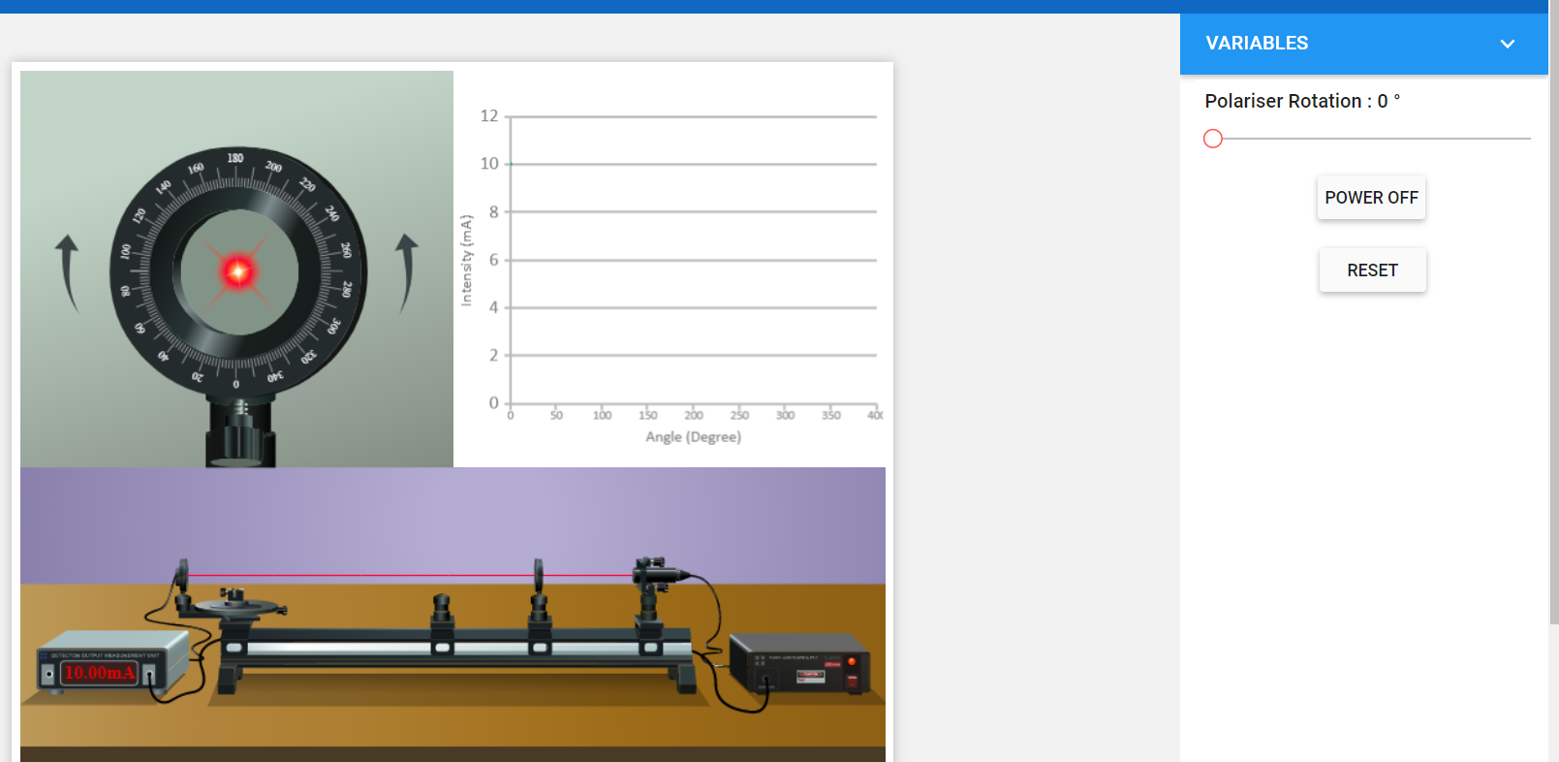
MALUS’ LAW SETUP (VIRTUAL)
Link :http://lo-au.vlabs.ac.in/laser-optics/Malus_law/experiment.html
(1) Click
(2) Rotate the Angle
(3) Note down the Current value

Slide 11
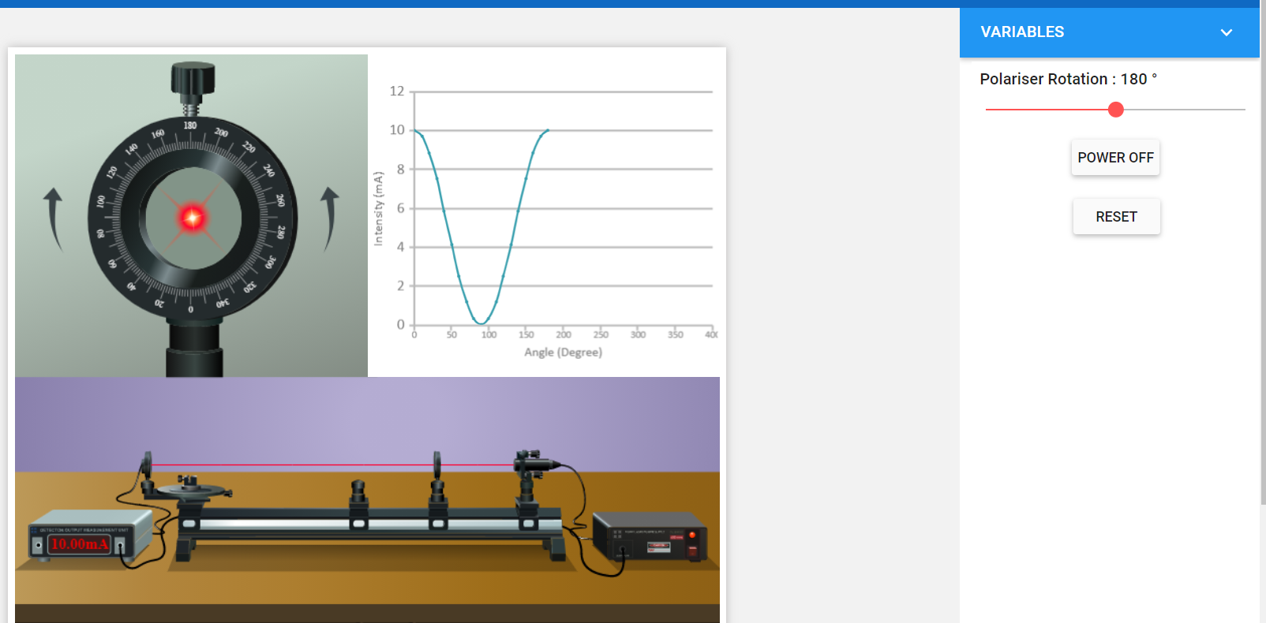
MALUS’ LAW SETUP (VIRTUAL)
Plot the graph from your own data

Slide 12
OBSERVATIONS
Maximum Current I_{max} = ….. mA
Sl. No. | Angle of Analyzer θ (Here it is Polarizer) Degrees | Cos θ | Cos² θ | Current I_{expt} | Current I_{theo} = I_{max} * Cos² θ
1.
2.
3.
4.

Slide 13
RESULT
Plot a graph between I_{expt} vs θ.
Discussion
The experimentally measured current (I_{expt}) and (I_{theo}) that calculated using equation I_{theo} = I_{max} Cos²θ agree within the limits of the experimental error.
References
http://lo-au.vlabs.ac.in/laser-optics/Brewsters_Angle_Determination/experiment.html
http://lo-au.vlabs.ac.in/laser-optics/Malus_law/experiment.html
https://www.iitr.ac.in/departments/PH/uploads/Teaching%20Laboratory/12%20Brewsters%20angle.pdf
https://www.iitr.ac.in/departments/PH/uploads/Teaching%20Laboratory/9%20Malus%20law.pdf

